Slide 1
30
For Y2 o3
⁴G_{11/2}
25
⁴H_{9/2}
⁴F_{3/2}
⁴F_{5/2}
ET
⁴F_{7/2}
20
²H_{11/2}
⁴S_{3/2}
ESA
⁴F_{9/2}
Energy (x 10³ cm⁻¹)
15
⁴I_{9/2}
²F_{5/2}
10
⁴I_{11/2}
NR
975 nm
⁴I_{13/2}
5
GSA
560 nm
660 nm
410 nm
0
²F_{7/2}
⁴I_{15/2}
Yb³⁺
Er³⁺

Slide 2
30
⁴G_{11/2}
⁴H_{9/2}
25
⁴F_{3/2}
⁴F_{7/2}
20
ET
²H_{11/2}
⁴S_{3/2}
ESA
⁴F_{9/2}
Energy (x 10³ cm⁻¹)
CR
15
⁴I_{9/2}
10
²F_{5/2}
⁴I_{11/2}
980 nm
⁴I_{13/2}
5
GSA
560 nm
660 nm
412 nm
²F_{7/2}
⁴I_{15/2}
0
Yb³⁺
Er³⁺

Slide 3
30
⁴G_{11/2}
⁴H_{9/2}
25
⁴F_{3/2}
⁴F_{7/2}
20
ET
²H_{11/2}
⁴S_{3/2}
ESA
Energy (x 10³ cm⁻¹)
CR
⁴F_{9/2}
15
⁴I_{9/2}
10
²F_{5/2}
⁴I_{11/2}
NR
975 nm
⁴I_{13/2}
5
GSA
560 nm
660 nm
412 nm
²F_{7/2}
⁴I_{15/2}
0
Yb³⁺
Er³⁺

Slide 5
30
⁴H_{9/2}
25
⁴F_{3/2}
⁴F_{7/2}
20
²H_{11/2}
⁴S_{3/2}
ESA
Energy (x 10³ cm⁻¹)
⁴F_{9/2}
³P₂
15
ETU
⁴I_{9/2}
³P₁
10
²F_{5/2}
⁴I_{11/2}
²F_{5/2}
NR
1064 nm
⁴I_{13/2}
1064 nm
excitation
5
GSA
560 nm
660 nm
GSA
412 nm
²F_{7/2}
¹P₀
²F_{7/2}
0
⁴I_{15/2}
Yb³⁺
Er³⁺
Bi³⁺
Yb³⁺

Slide 6
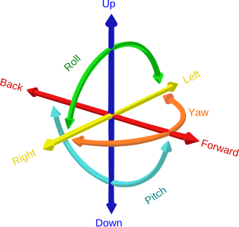

Slide 7
30
⁴H_{9/2}
25
⁴F_{3/2}
⁴F_{7/2}
20
²H_{11/2}
⁴S_{3/2}
ESA
Energy (x 10³ cm⁻¹)
⁴F_{9/2}
³P₂
15
ETU
⁴I_{9/2}
³P₁
10
²F_{5/2}
⁴I_{11/2}
²F_{5/2}
NR
1064 nm
⁴I_{13/2}
1064 nm
excitation
5
GSA
560 nm
660 nm
GSA
412 nm
²F_{7/2}
¹P₀
²F_{7/2}
0
⁴I_{15/2}
Yb³⁺
Er³⁺
Bi³⁺
Yb³⁺

Slide 8
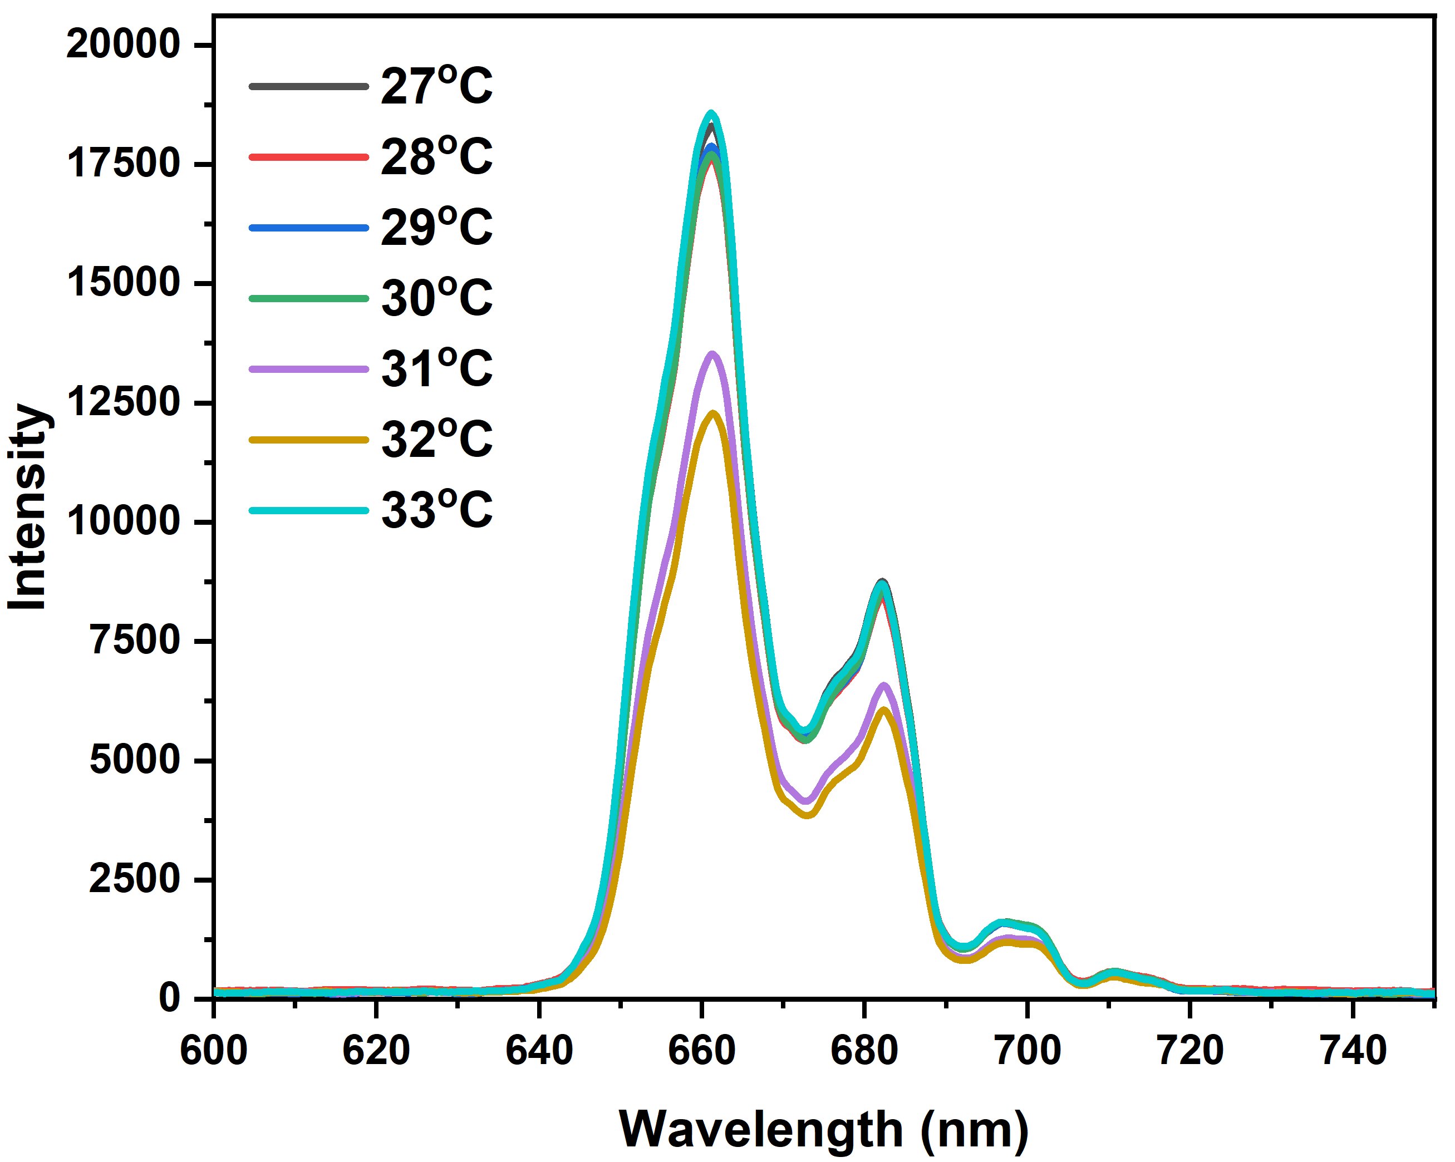
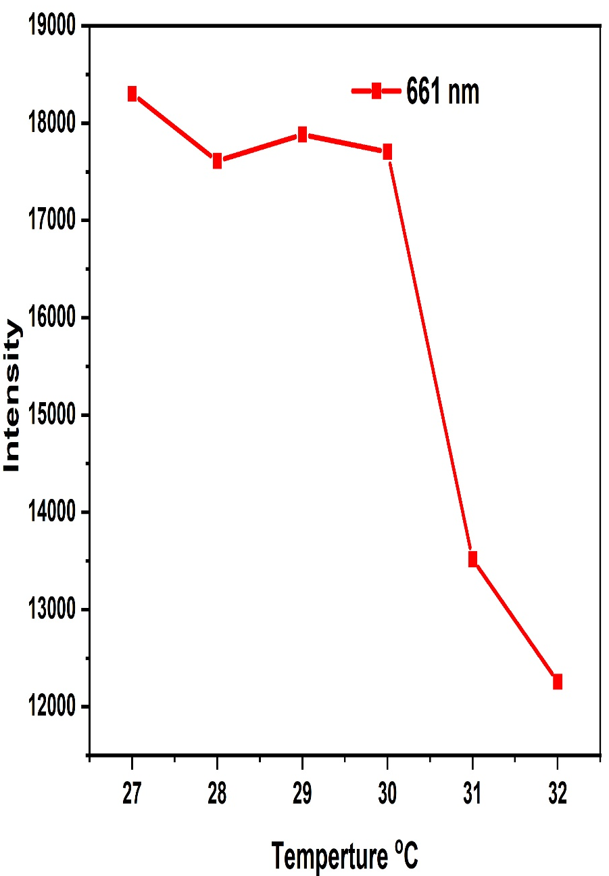

Slide 9
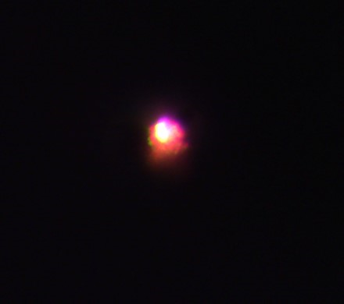

Slide 10
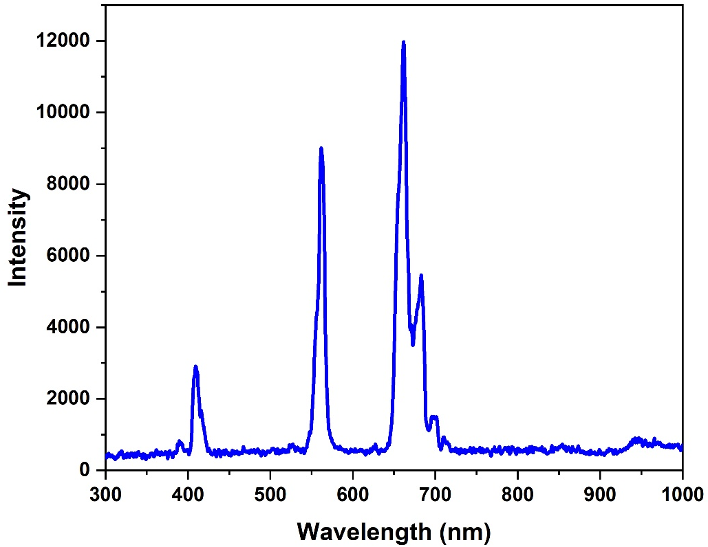

Slide 11
